Slide 1
Summarizing paragraphs of a given document, keywords extraction.
Team: Meta

Slide 2


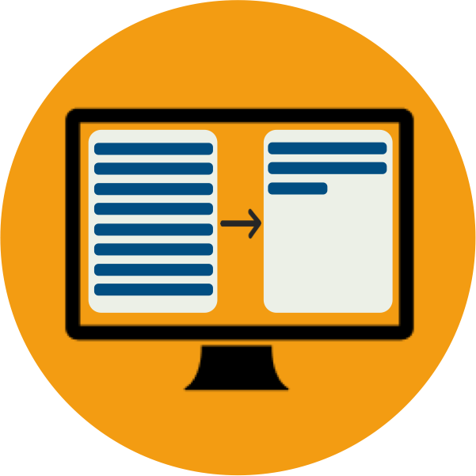
Summarizing paragraphs of a given document, keywords extraction.
Brief
summary
Text summarization
Keyword extraction
Web Interface
Summarize text accurately and fast
Extracting given keywords
Simple interface to run modules

Slide 3
Project timing
Building web interface and finishing the project
3 weeks
Development (modules)
6 weeks
Phase 2
Phase 4
Research and planning
Phase 3
3 Weeks
Testing all the modules and connecting them under one framework
4 weeks

Slide 4
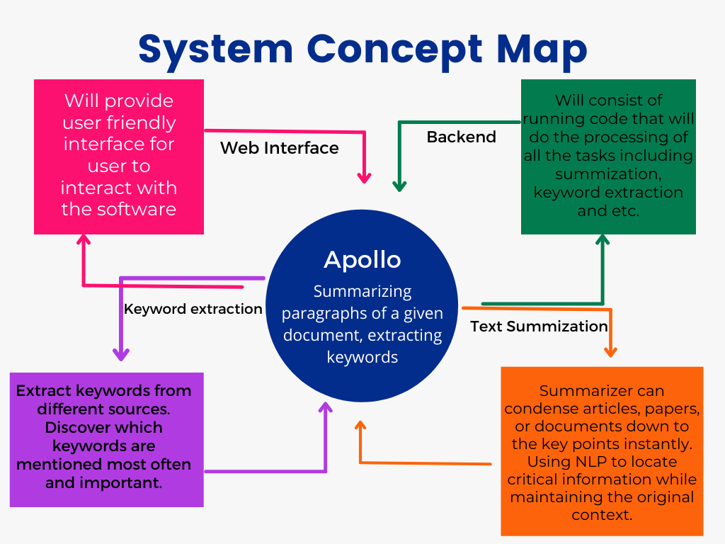
Basic overview and modules

Slide 5
Flowchart
01
02
03
04
Initialization
Train and testing
Prepare Keyword extraction model
Connect all features into a framework
Upload the data to train the NLP algorithm
Check the accuracy of the model with help of test dataset
Making the keyword extraction function
Put all the feature (summarization/keyword extraction) into one framework and web interface.

Slide 6
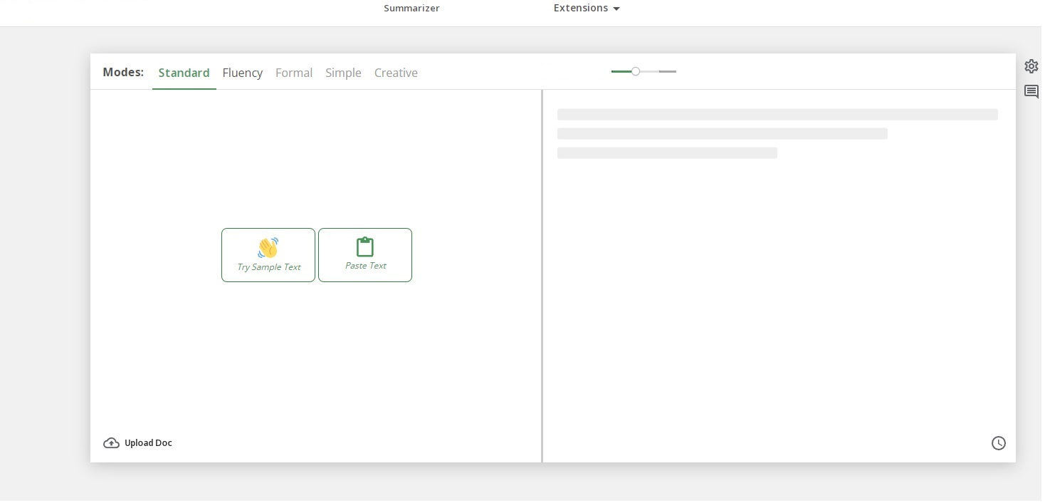
Interface sample

Slide 7
Target Market
Education Fields
Text summarization can help students to save their time and offer summarized context of their curriculum
Research centers
Make it easy by saving time and offering summarized and keyword extracted contexts which they may spend triple time otherwise.
Individual use
Individuals can summarize and take keywords from the articles and books they are reading

Slide 8

QuilBot
One of the competitive summarizing web app
I
30,140,242 monthly visits
6.13 %
Monthly visit grow

Slide 9
Thanks!
Do you have any questions?
Please feel free to ask!

