Slide 1
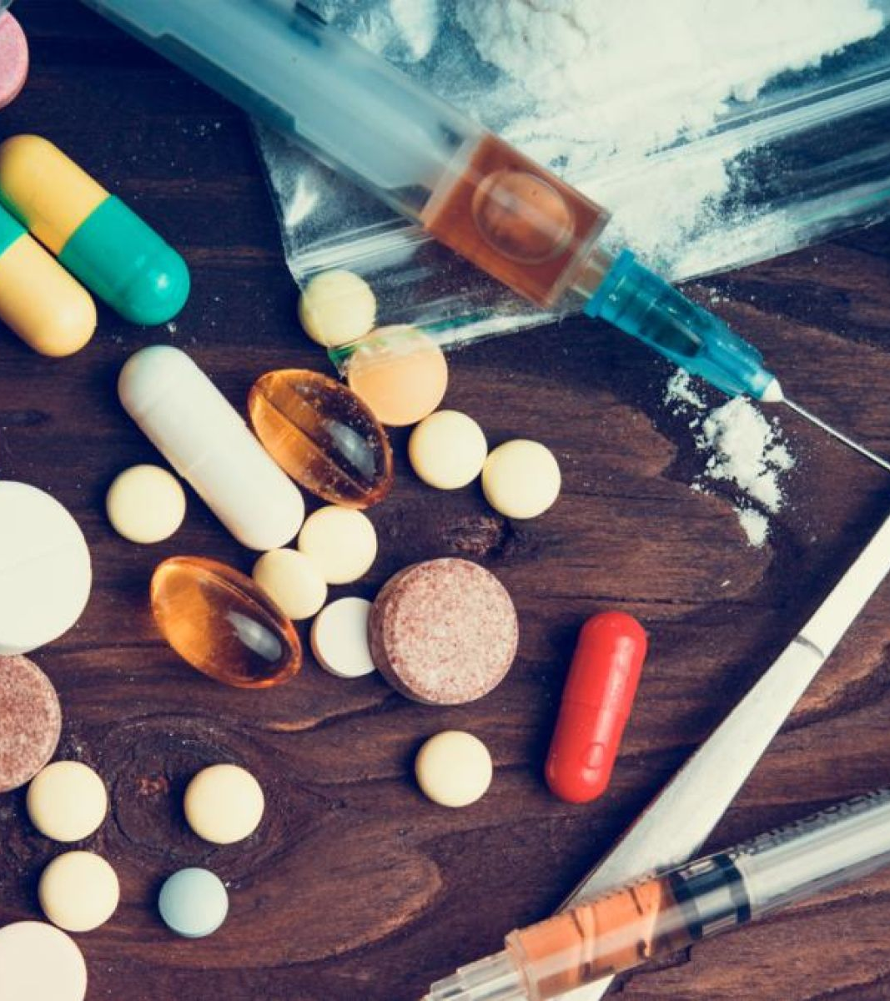

Drug
Detection
VANESSA GARZA ENRIQUEZ
YANG SEONG JIN
JAMSHIDBEK UROLOV

Slide 2
Project Goal
Detect drugs fast and accurately
Catch drug dealers
Help with forensic investigation

Slide 3
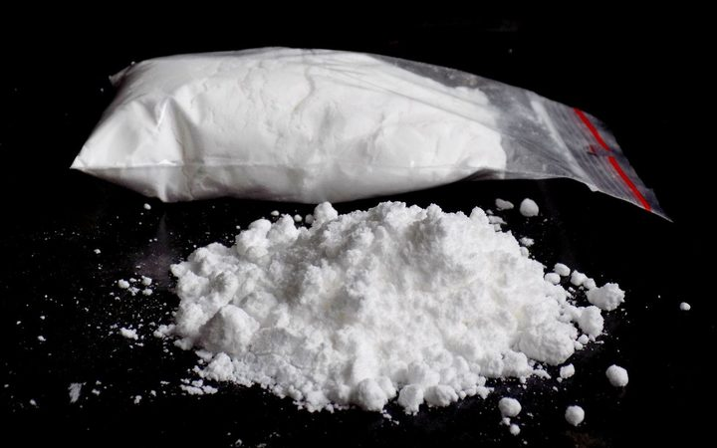
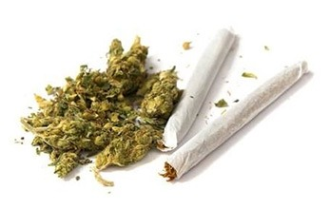
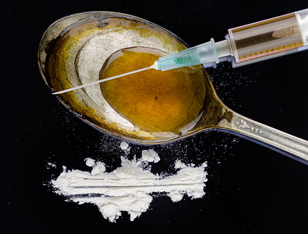
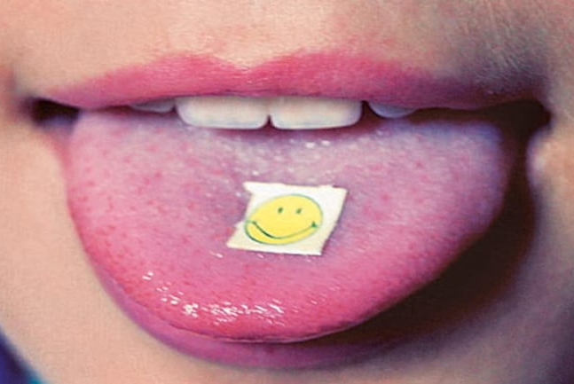
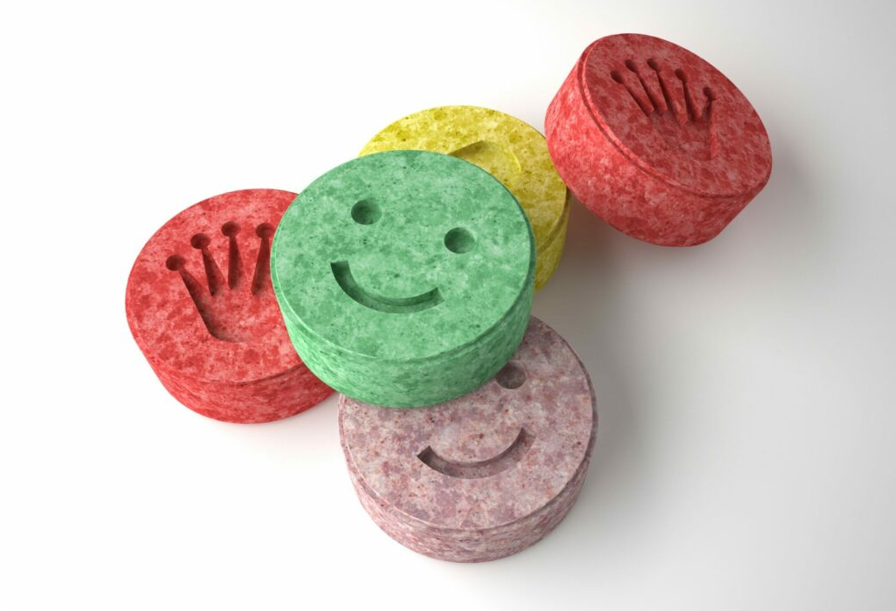
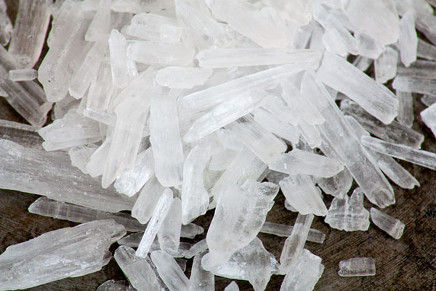
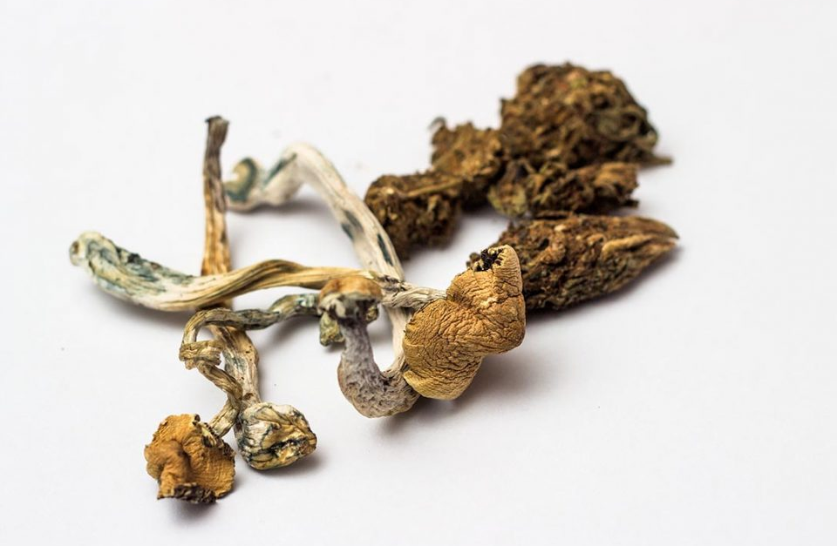
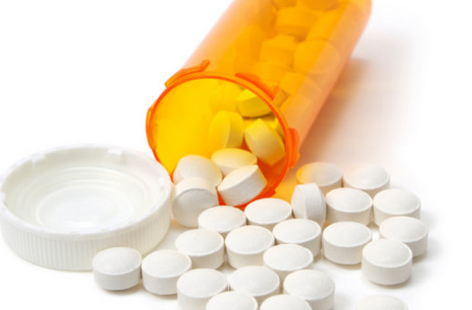
List of Drugs
Cocaine
Marijuana
Heroin
LSD
Ecstasy
Meth
Shrooms
Opioids

Slide 4
Schedule
세부내용 | 수행기간(월) |  |  |  |  |  |  |  |  |  |  |  |  |  |  |  | 비고
 | 3 |  |  |  | 4 |  |  |  | 5 |  |  |  | 6
 | 1 | 2 | 3 | 4 | 1 | 2 | 3 | 4 | 1 | 2 | 3 | 4 | 1 | 2 | 3 | 4
1. Plan establishment | O | O
2. Data investigation |  | O | O | O | O | O | O
3. Training dataset |  |  |  |  |  | O | O | O | O | O
4. Implementation |  |  |  |  |  |  |  |  |  | O | O | O | O | O | O
5. Testing |  |  |  |  |  |  |  |  |  |  |  |  |  |  | O | O

Slide 5

Software Architecture
Start
Third party image pre-processing
Feature extraction
Database inquiry
Input video file
Drugs detected?
yes
no
Overlay drug names on detected drugs
Classify drugs
End
End

Slide 6
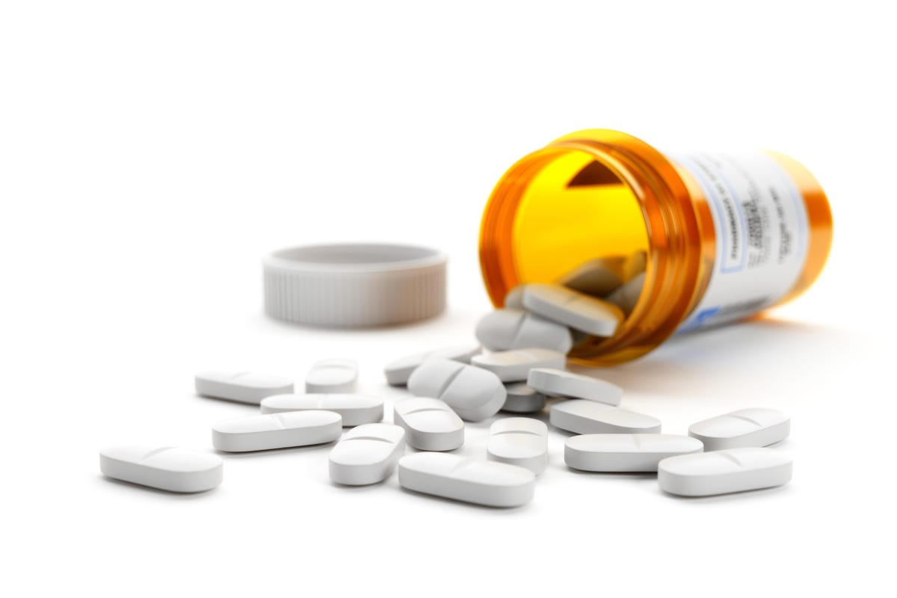
Module Requirements
Matplotlib 3.2.2
Numpy 1.18.5
Open CV 4.1.2
Pillow 5.3.1
PyYAML 2.23.0
SciPy 1.4.1
Torch 1.7.0
Torchvision 0.8.1
Tqdm 4.41.0
Tensorboard 2.4.1
Pandas 1.1.4
Seaborn 0.11.0
Coremltools 4.1
Onnx 1.9.0
Onnx-simplifier 0.3.6
Coremltools 4.1
Scikit-learn 0.19.2
Tensorflow 2.4.1
Tensorflowjs 3.9.0
Openvino-dev
Albumentations 1.0.3
Pycocotools 2.0
Cython
Roboflow
thop

Slide 7
Interface Design
Drug Detection
Upload file
Analyze
video.mp4
Successfully uploaded

Slide 8
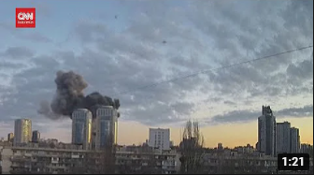
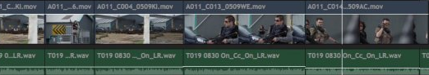
Interface Design
Drug Detection
Marijuana: 0
Cocaine: 0
Heroin: 2
LSD: 0
Ecstasy: 0
Meth: 0
Shrooms: 1
Opioids: 0
Total: 3
Analyze
Create video
Create report

Slide 9
Thank you
Q&A

