Slide 1





Capstone Project
Team
Let's reflect on what went well and what did not go well to improve the way we work.
Naver
Usmonkul Khakimov
Shokhruhbek Primkulov
Iskandar Gulyamov

Slide 2

Project Plan
1
Overview
3
Expected Effect
1)Detect Symbols on the blurred images of License plate
1) Deploy our working prototype for the government security road camera system
2) identify car owners who brake the law
2
Goal
In real-world applications, our model expected to recognize LP numbers directly from relatively high-resolution
images at over 61 fps and 98.5% accuracy.

Slide 3
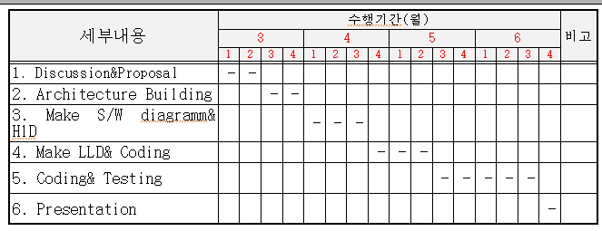
Project Plan
4
Schedule Overview

Slide 4
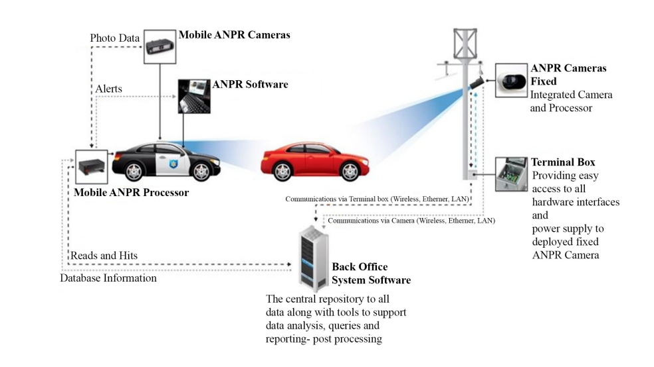
Use Case Scenario

Slide 5
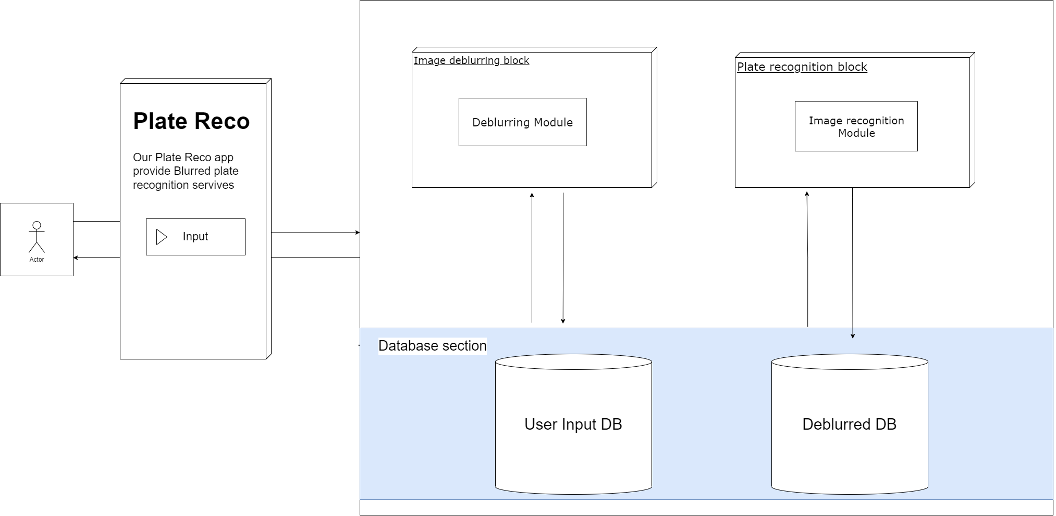
Software Architecture

Slide 6
High Level Design
Brief functionality of Deblurring Module
  Pre-processing– The aim is to eliminate noise or distortion from the input image and make it simpler to carry out all processing operations.
  Blur Angle Estimation – estimation level of blurriness in angle.
  Blur Length Estimation – obscure length is evaluated using the cepstral transform method
  Deconvolution - Here NBID method is used to get back the original deblurred image.

Slide 7
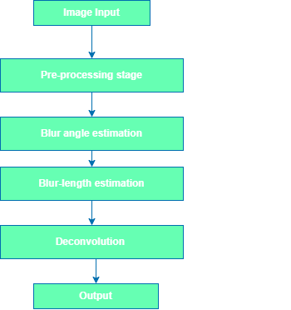
Interfaces among DB model

Slide 8
High Level Design
Brief functionality of Image Recognition Module
  Plate localization – responsible for finding and isolating the plate on the picture
  Plate orientation and sizing – compensates for the skew of the plate and adjusts the dimensions to the required size
  Normalization – adjusts the brightness and contrast of the image
  Character segmentation – finds the individual characters on the plates
  Identification - character recognition from individual zones previously identified.
  Regionalization - regional syntactical correction to identify ambiguities on apparently identical characters (I = 1, O = 0 , B = 8)

Slide 9
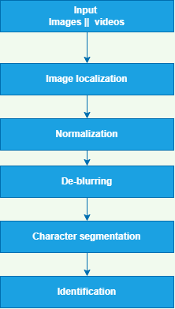
Interfaces among PR

Slide 10

Naver
March 30, 2022
We're
Thank you for participating. Have a great day ahead.
done!

